Slide 1


A Day in the Life of a DBA
Notes:
De Bellis Antiquitatis

Slide 2
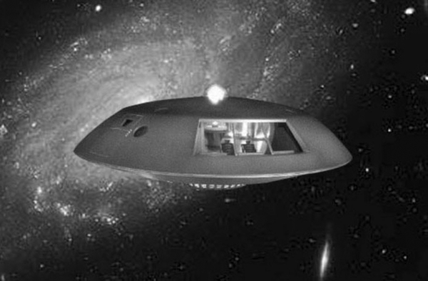
Agenda
Launch
What now?
Technology to the Rescue
More Technology
Repairing the ship (again)
Re-Launch
The Rules

Slide 3
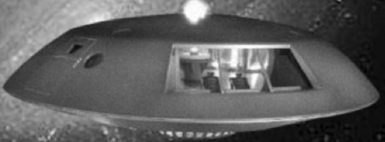
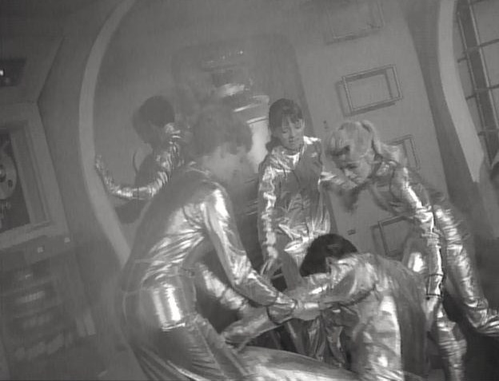

Launch: Morning Emails
Notes:
An alert,
Presenter’s phone goes off or they pretend it does.
SQL Monitor – Show an alert, maybe for a deadlock or a failed backup, then how to diagnose based on the information provided & fix it. Possibly add space monitoring to prevent problem in the future.

Slide 4


Launch: Morning Emails
Failed non-critical jobs
Space Alerts
Performance Alerts
Work Requests
Security
Tuning
Deployments
Questions
Notes:
SQL Monitor
Demo goes back to SQL Monitor, but concentrates on long running queries to get to a point in time in Monitor.

Slide 5

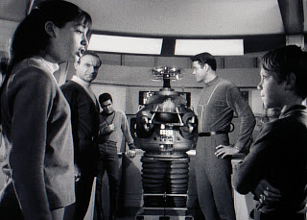

What now? Meetings
Warehouse
Reports
Applications
Business
Servers
Vendors
Notes:
?
SQL Doc?
Depedency Tracker?
This is a part of the day in the life, but we could skip it since we don’t have anything really important to demo.

Slide 6
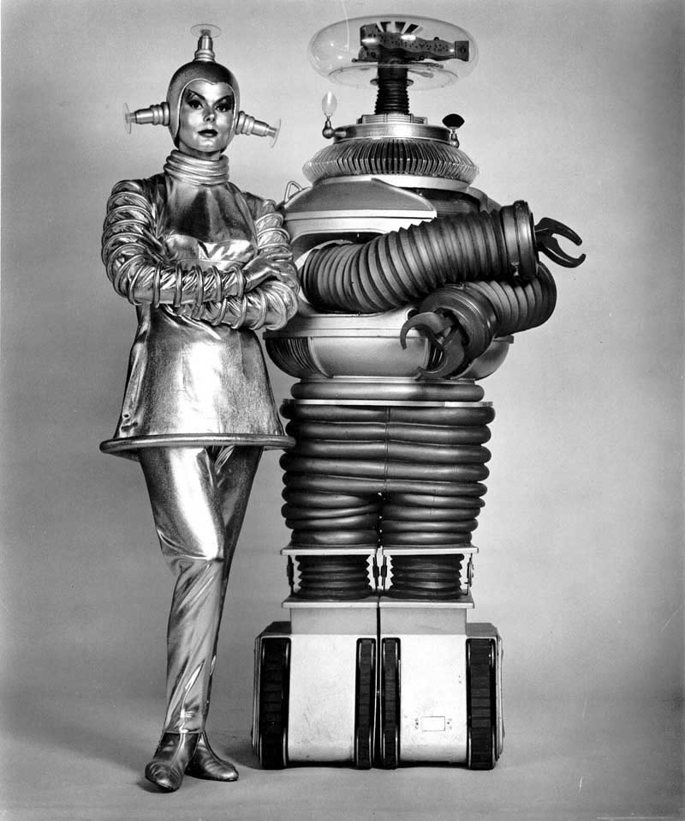
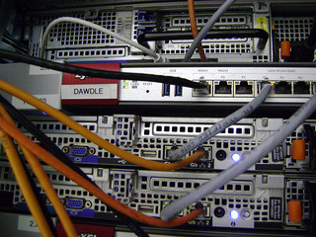
Technology to the Rescue A New Server
Do we really need one?
Virtual or Physical
Defining
Purchasing
High Availability
Cluster
Mirror
SAN
Disaster Planning
Notes:
SQL Monitor
SQL Backup – include possibility of offsite storage, mention anyway
Demo would be setting up backups for a server?

Slide 7
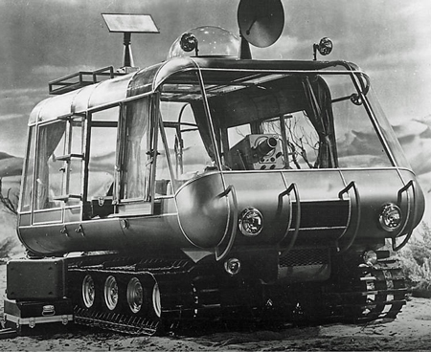
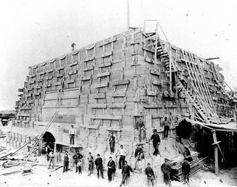
More Technology The New App
Requirements
A new database
Normalization
Indexing
Code
Allocation
Design Review
Change Management
Testing
Notes:
Deployment Manager
SQL Source Control
SQL Compare
SQL Prompt
TsqlT
Demo… either quick connection to source control or deploy a change. Probably not time for both.

Slide 8
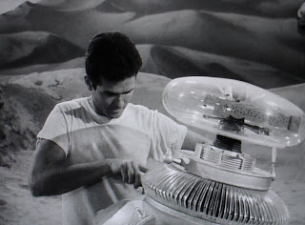
Reparing the Ship (Again) The Old Database
Space Management
Performance Tuning
Monitoring
Maintenance
Notes:
SQL Compare
SQL Data Compare
SQL Monitor
SQL Backup
Demo… Up to this point we’ve done monitor & backup, so Compare?

Slide 9



Re-Launch Production Deployment
Document Process
Source Control
Test Deployments
Deploy
Validate Deployment
Rinse & Repeat
Notes:
Deployment Manager
SQL Compare
SQL Data Compare
SQL Backup
SQL Monitor
Show a little command line automation through PowerShell for Compare & SQL Source Control?

Slide 10




The Rules
Backups
Documentation
Automation
Test Everything
Learn the Business
Network
Learn the Technology
Practice
Never Trust Dr. Smith

Slide 11


The End? Questions?

